Slide 1
Economic Data
Analysis
Economic Impact on Consumer Auto Loans

Slide 2
Economic Impact on Consumer Auto Loans
Project Goal: Outline of the project is to understand how economic factors influence consumer auto loans.
Key Focus Areas: GDP, Loan Amounts, Finance Rates, Delinquency Rates
Relevance: Understanding these relationships offers insights into consumer behavior and the stability of the auto loan market.
Methodology: Historical data review, focusing on correlations between economic indicators and loan trends.

Slide 3
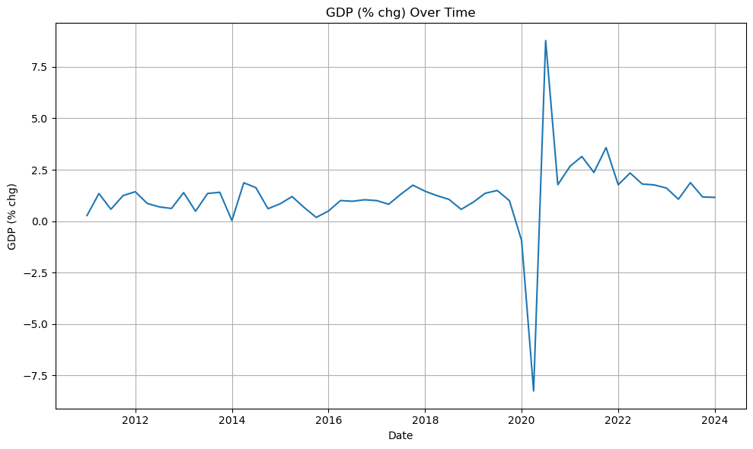
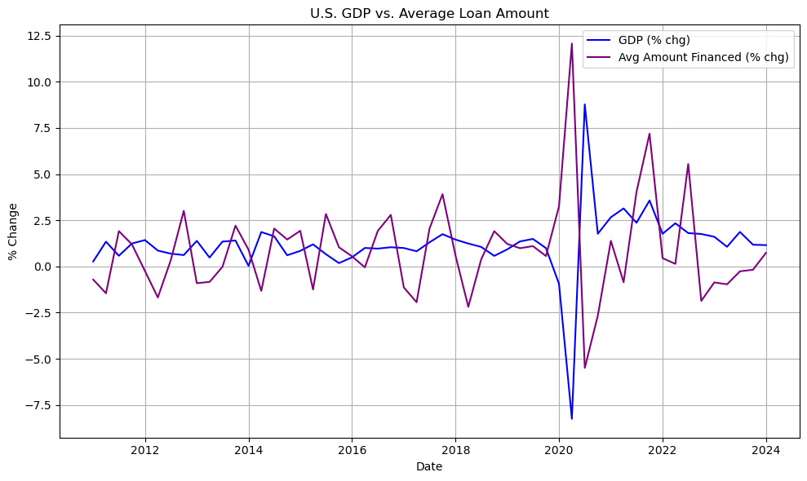
U.S. GDP and Its Influence on Key Loan Indicators
GDP Overview: GDP reflects economic health and growth. Rising GDP often correlates with increased consumer spending and borrowing.
Consumer Lending Context: Typically, GDP growth supports greater consumer lending, while contractions may lead to borrowing declines.
Link to Auto Loans: GDP changes directly influence consumer demand for auto loans, as a stronger economy often increases loan demand.
Data Highlights: Our analysis found a moderate negative correlation (r = -0.58) between GDP growth and average loan amounts. As GDP increased, consumers borrowed smaller amounts for auto loans.

Slide 4
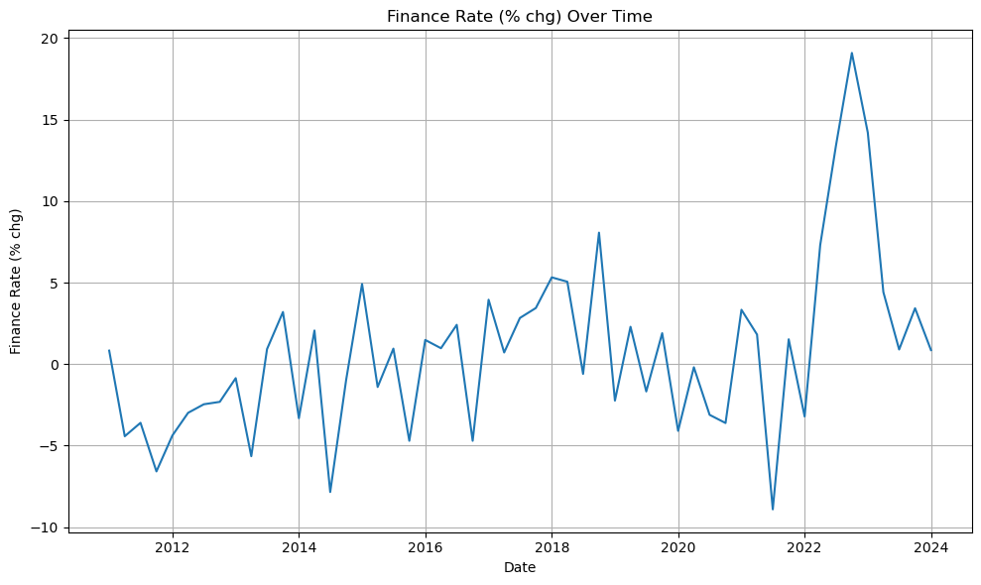
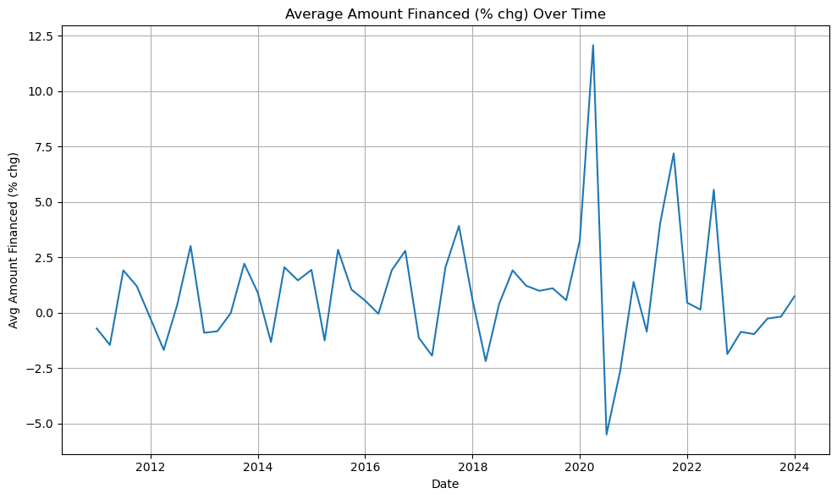
Analysis of Average Loan Amounts and Finance Rates
Loan Amount Trends: Average loan amounts showed a downward trend as GDP grew, suggesting consumers might be cautious in higher-growth economies or have access to other financing sources.
Finance Rate Trends: Over time, finance rates fluctuated, showing weak correlation with loan amounts (r = -0.03).
Impact of Economic Conditions: Lower finance rates generally coincide with economic growth, encouraging borrowing. However, this effect was minimal in influencing average loan amounts in our data.
Consumer Insights: Consumers may not significantly adjust loan amounts in response to finance rate changes, suggesting other factors impact loan size decisions.

Slide 5
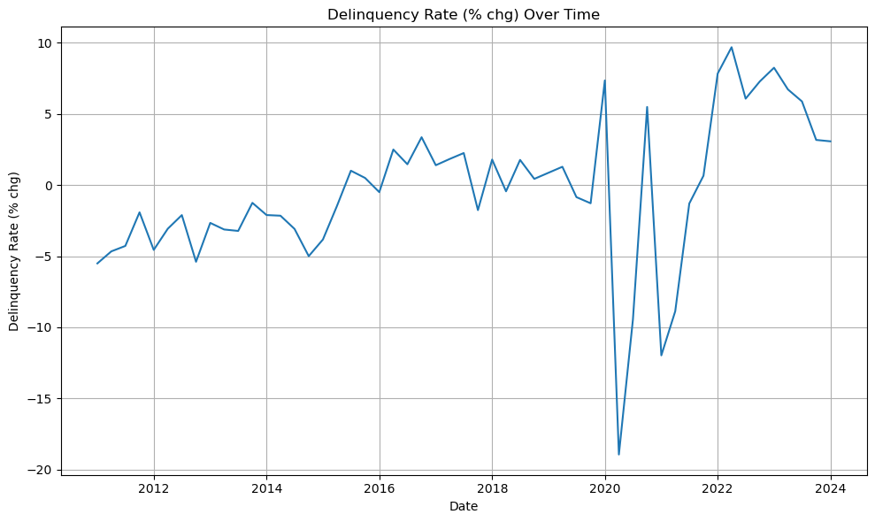
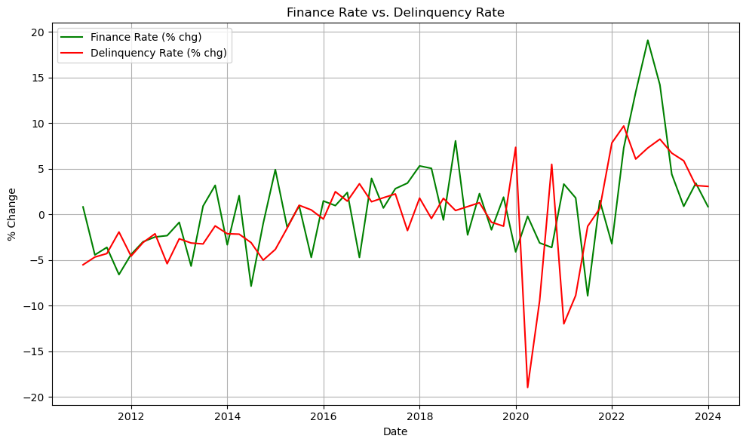
Consumer Delinquency Rates: Trends and Risks
Delinquency Rate: Defined as the percentage of loans overdue, it’s a critical risk metric for lenders.
Delinquency Trends: The data shows that delinquency rates moderately correlate with finance rate changes (r = 0.36), suggesting rising finance rates increase delinquency risks.
Economic Impact: Economic downturns or higher interest rates put pressure on borrowers, leading to higher delinquency rates.
Risks to Lenders and Consumers: High delinquency rates impact lender profitability and can signal economic stress, affecting both lenders and broader economic stability.

Slide 6
Conclusion: Key Insights and Market Implications
Summary of Findings:
GDP and Loan Amounts: A moderate negative correlation indicates that higher GDP might reduce average loan amounts.
Finance Rates and Delinquency: Positive correlation highlights a risk as finance rates rise, delinquency rates increase.
Market Implications: These trends suggest that economic growth may not always drive higher loan amounts, while rising rates are a risk factor for loan defaults.
Future Considerations: Monitor changes in interest rates and economic shifts as they may impact auto loan behavior.
Stakeholder Takeaway: Insights are critical for lenders, policymakers, and consumers, indicating areas to watch for lending risk and consumer financial health.
Indicator Pair | R-value | P-value | Relationship
GDP & Delinquency Rate | +0.20 | 0.14 | Weak positive correlation
GDP & Avg Amount Financed | -0.58 | <0.001 | Moderate negative correlation
Finance Rate & Avg Loan Amount | -0.03 | 0.83 | Very weak correlation
Finance Rate & Delinquency | +0.36 | 0.009 | Moderate positive correlation

Slide 7
Questions

